Slide 1
Programming with B4X
Lesson 11 – First Project
Anywhere Software
March 2021

Slide 2
Today you will learn
Create a full project

Slide 3
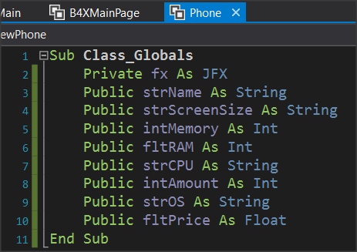
1.1 Phone class Attributes

Slide 4
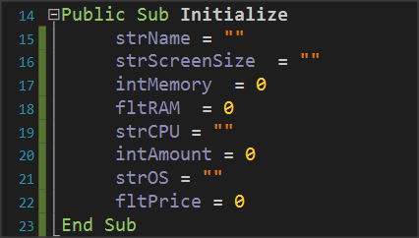
1.2.1 Initialize

Slide 5
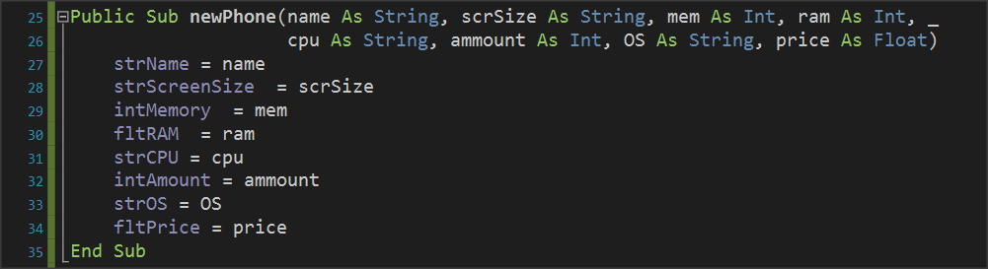
1.2.2 newmodel Method

Slide 6

1.2.3 storage Method

Slide 7
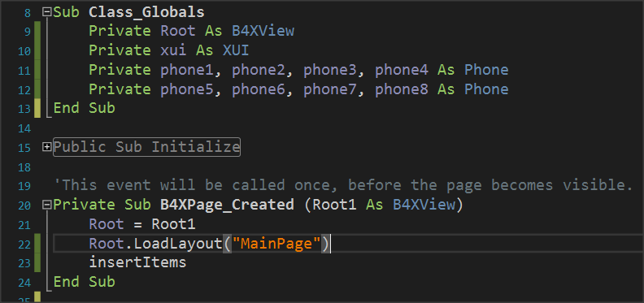

2. Create Objects
First create variables

Slide 8
Objects
 | Model Name | Screen | Capacity | RAM | CPU | OS | Store | Price
1 | Phone1 | 6.53'' | 64 | 4 | Mediatek | Android | 12 | 150$
2 | Phone2 | 6.67" | 64 | 4 | Qualcomm | Android | 4 | 220$
3 | Phone3 | 6.1 | 128 | 4 | Bionic | IOS | 7 | 780$
4 | Phone4 | 5.8’’ | 64 | 4 | Mediatek | Android | 12 | 150$
5 | Phone5 | 5.8’’ | 32 | 3 | Mediatek | Android | 16 | 130$
6 | Phone6 | 5.8’’ | 32 | 2 | Mediatek | Android | 16 | 90$
7 | Phone7 | 5.8’’ | 64 | 3 | Qualcomm | Android | 2 | 170$
8 | Phone8 | 6.67’’ | 128 | 6 | Qualcomm | Android | 4 | 650$

Slide 9
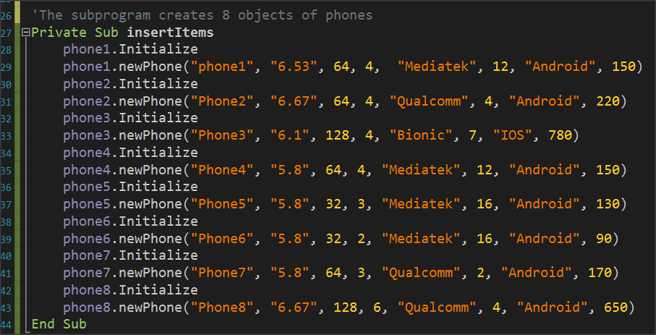
2. Create Objects
make a sub to insert Objects

Slide 10
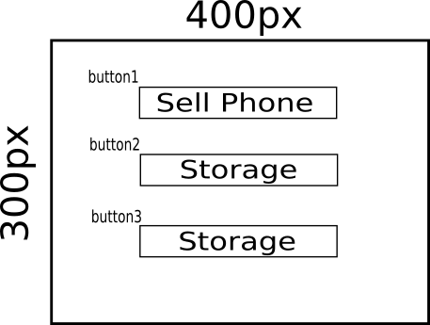
3. Create main Screen
First design a wireframe

Slide 11
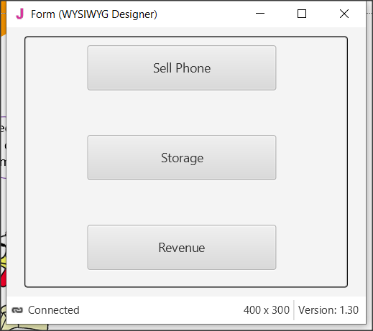
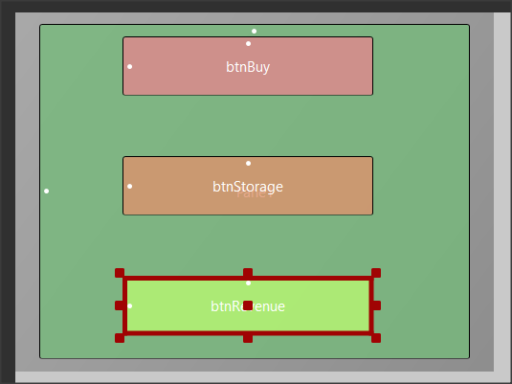
3. Create main Screen
Second, open the designer and make the form

Slide 12
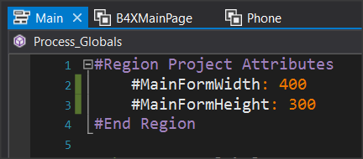
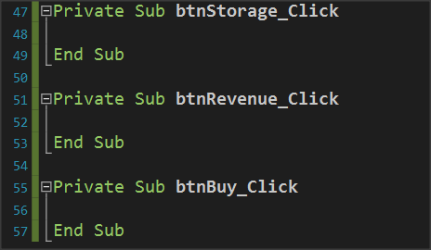
3. Create main Screen
Generate members: click method for the 3 buttons

Slide 13
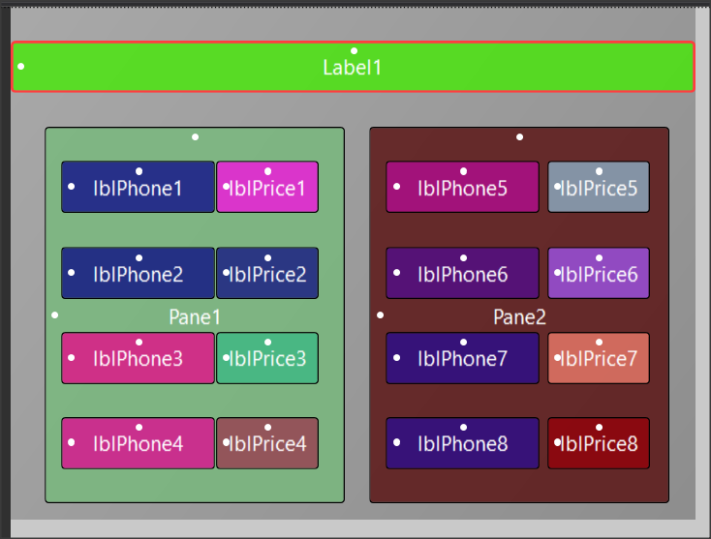
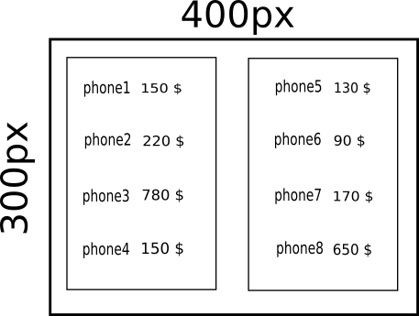
4. Sketch wireframe and design form

Slide 14
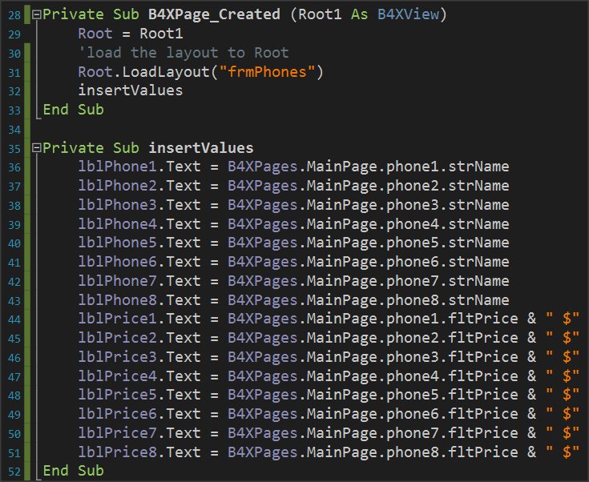
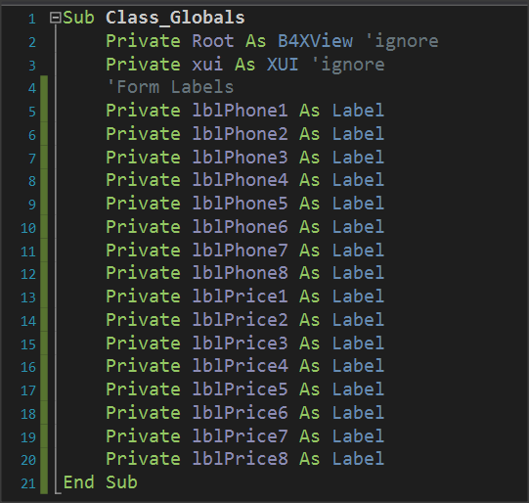
4. Write code for labels

Slide 15

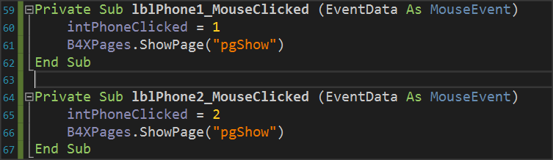
4. Write MouseClicked events
Declare a global Variable to store Phone clicked
Create a B4XPage to show information's
For lblPhone Create a mouseClicked event.
Store in public variable the object number. You
Will use it later in Informations B4XPage

Slide 16
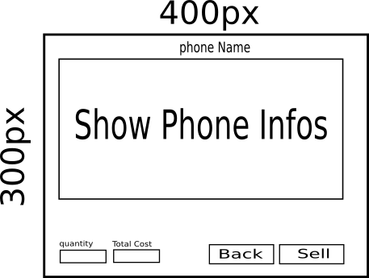
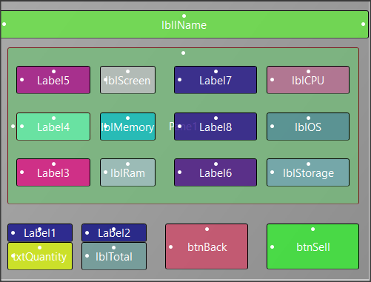
4.1 Design Information Screen
make the form

Slide 17
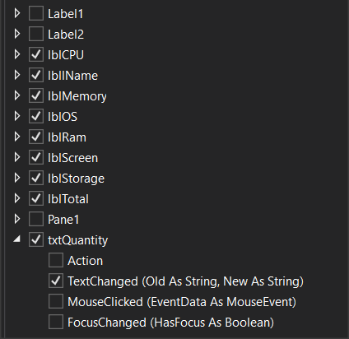
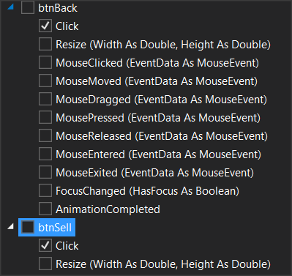
4.1 Generate Members

Slide 18
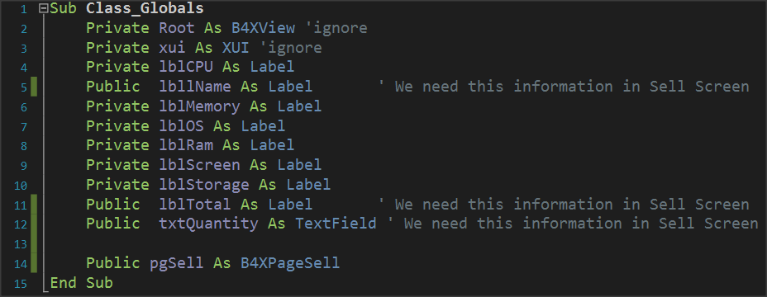
4.1 Variables

Slide 19
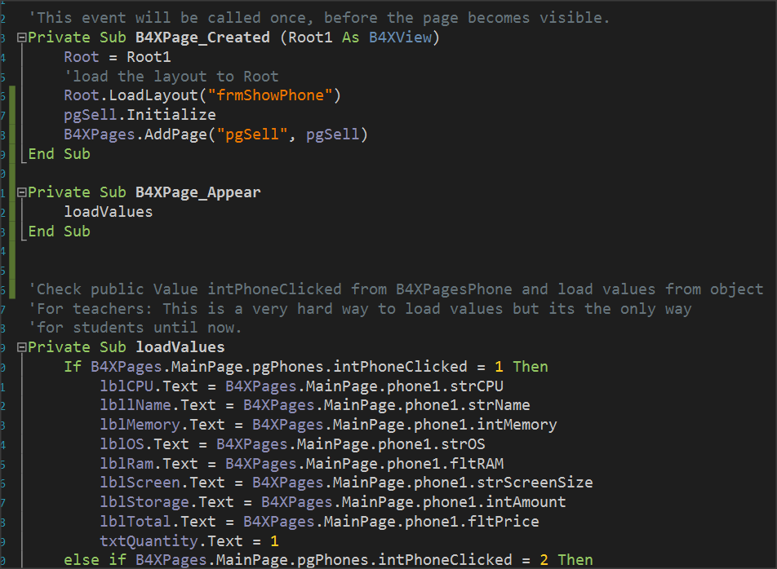
4.1 Load Values
Don’t forget to continue if statement for all objects

Slide 20
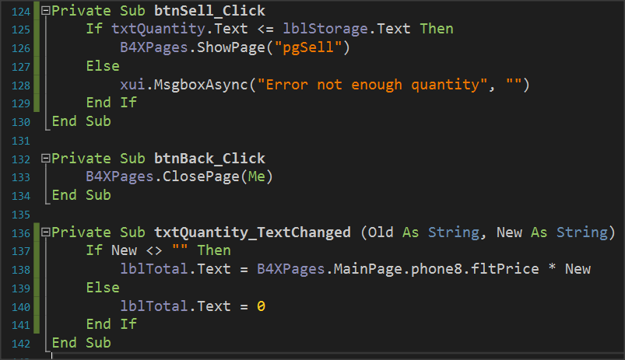

4.1 Events
Remember the if statement or it will try to multiply with empty value.

Slide 21
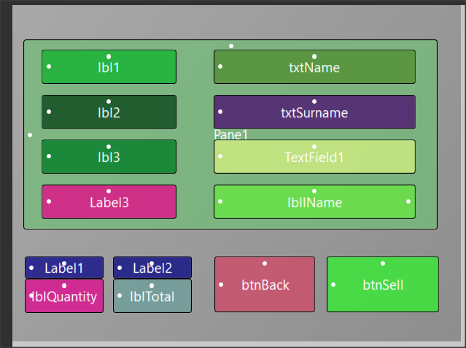
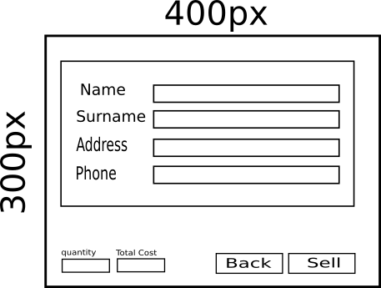
4.1.2 Sell Screen

Slide 22
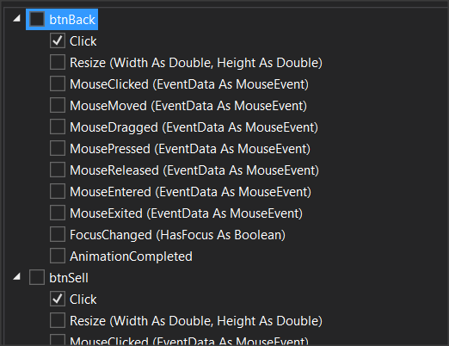
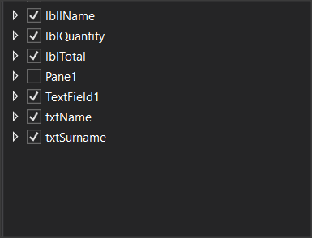
4.1.2 Generate members

Slide 23
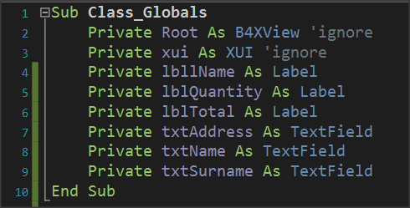
4.2 Variables

Slide 24
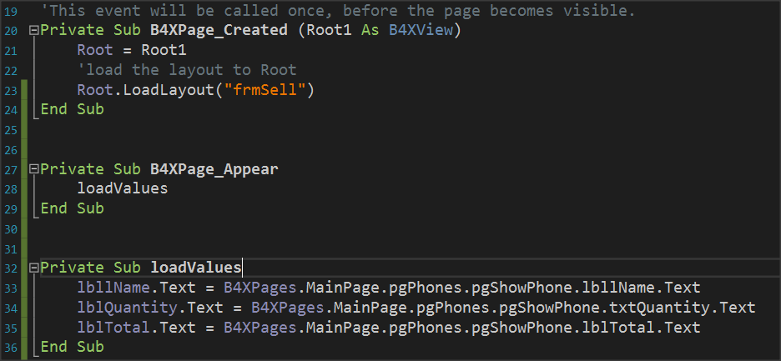
4.1.3 Load Values

Slide 25
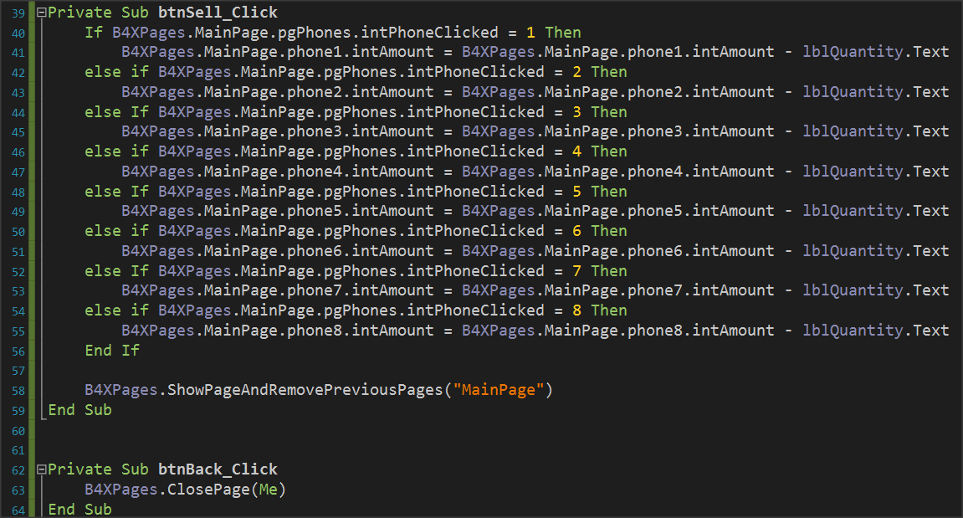
4.1.4 Events

Slide 26
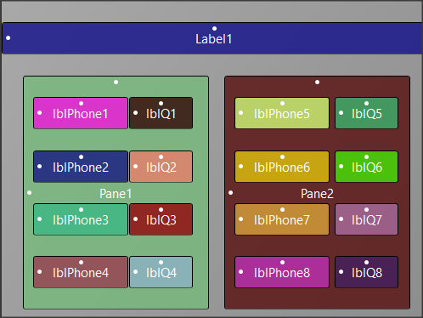
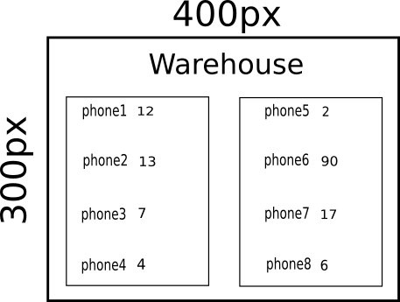
5. Warehouse – Design Form

Slide 27
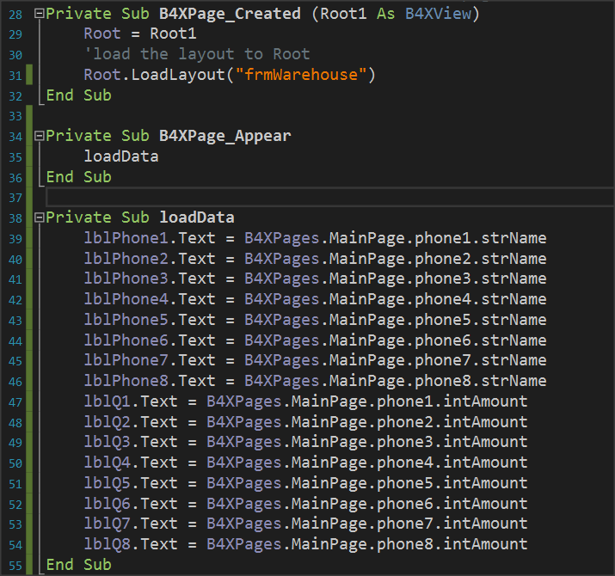
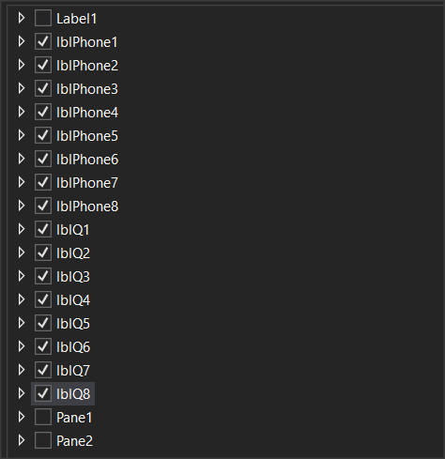
5. Generate Members and Load Data

Slide 28
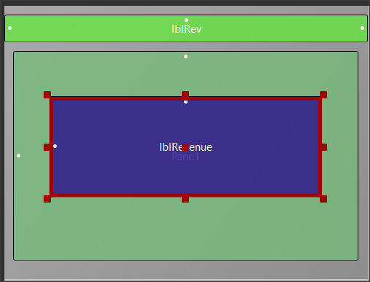
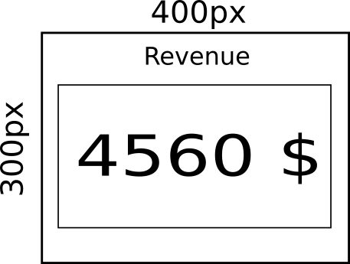
6. Revenue – Design Form

Slide 29
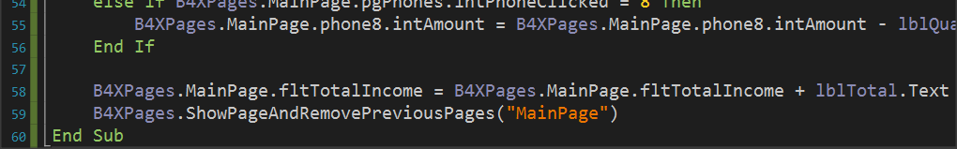
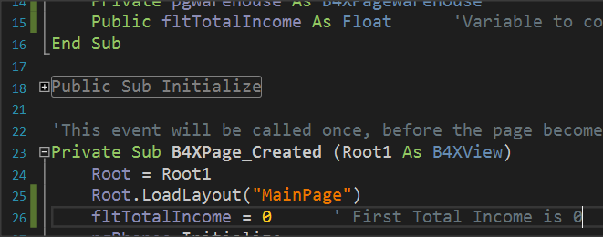
6. Revenue
Before create Revenue Page do:
When a sell is complete add to fltTotalIncome new Total
Create a Public float Variable into MainPage

Slide 30
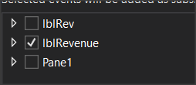
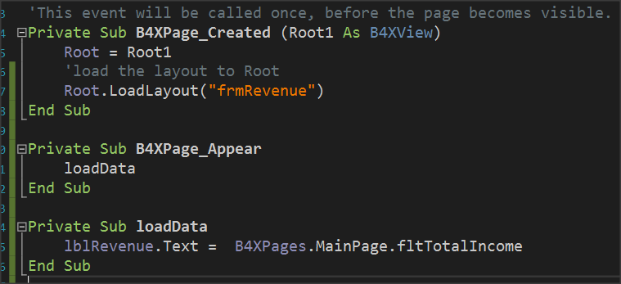
6. Generate Members & Load Data

Slide 31
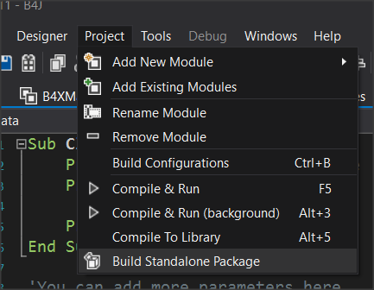
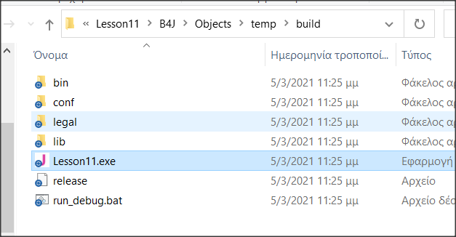
Compile and Create stand alone Application
A new folder will appear in file manager
Now you can run your new application by double clicking the .exe file

Slide 32

Thank you!!!

